Slide 1
MAJOR PROJECT PPT ON
EVENT MANAGEMENT

Slide 2
Company Profile
INFOWIZ is an ISO certified company. It has been working from more than 5 years in the field of IT and Web Development and has been providing its clients with its exceptional and quality Web Design, Development and SEO services. Our clients range from individuals to professionals and small, medium and large scaled Businesses. In 2008, INFOWIZ entered into IT outsourcing and partnered successfully with many offshore web and SEO companies of US, UK, France, Ireland, Canada, and Australia etc. to provide them quality and timely services.

Slide 3

Introduction to PHP:

Slide 4
What is PHP?
PHP == ‘Hypertext Preprocessor’
Open-source, server-side scripting language
Used to generate dynamic web-pages
PHP scripts reside between reserved PHP tags
This allows the programmer to embed PHP scripts within HTML pages

Slide 5
During Training We have Study About
Introduction of HTML.
DHTML
CSS
JAVASCRIPT
PHP
ADVANCE PHP
JOOMLA
AJAX
WORDPRESS

Slide 6
About the project
Event Management is a online website that is use for searching all services required for organizing an event.
This site include two main part Admin section, User section and Vendor section.
Admin can view all services and make changes in the entire site.
User can view all services as well as book services and edit their account.
Vendor can view booked services,confirm services and make changes in their account.

Slide 7
FrontEnd:
HTML
CSS
JAVASCRIPT
PHP

Slide 8
BackEnd:
My Sql
WAMP Server

Slide 9
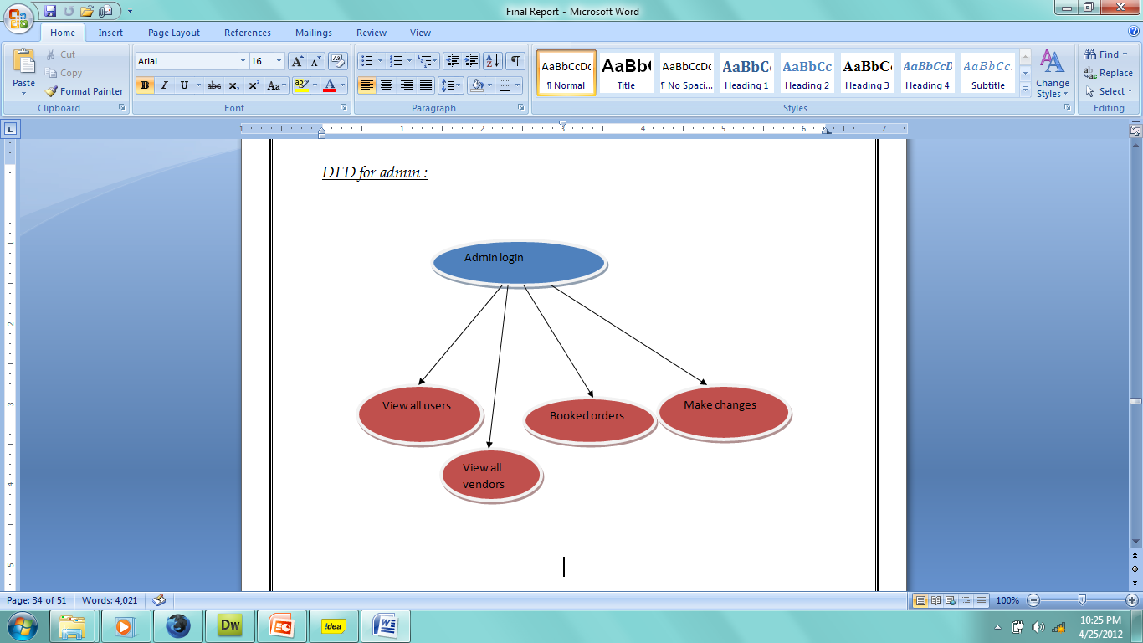
DFD for Admin

Slide 10
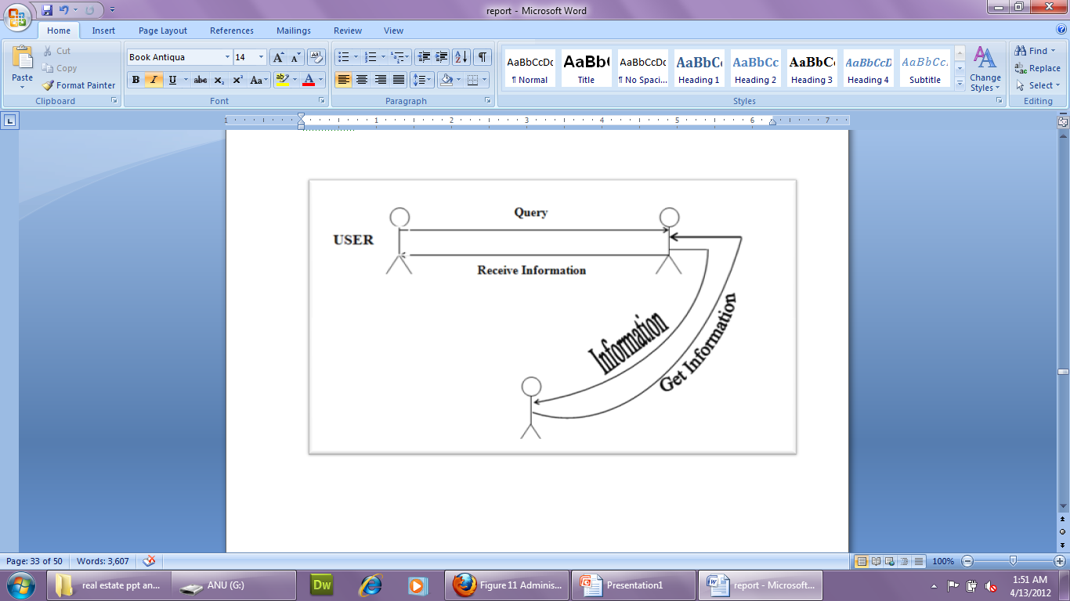
DFD for client

Slide 11





Snap Shot’s of project
Event Management

Slide 12
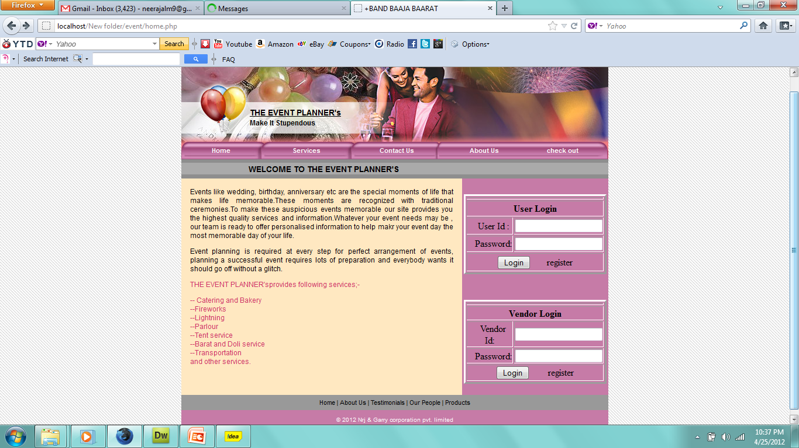
Home page

Slide 13
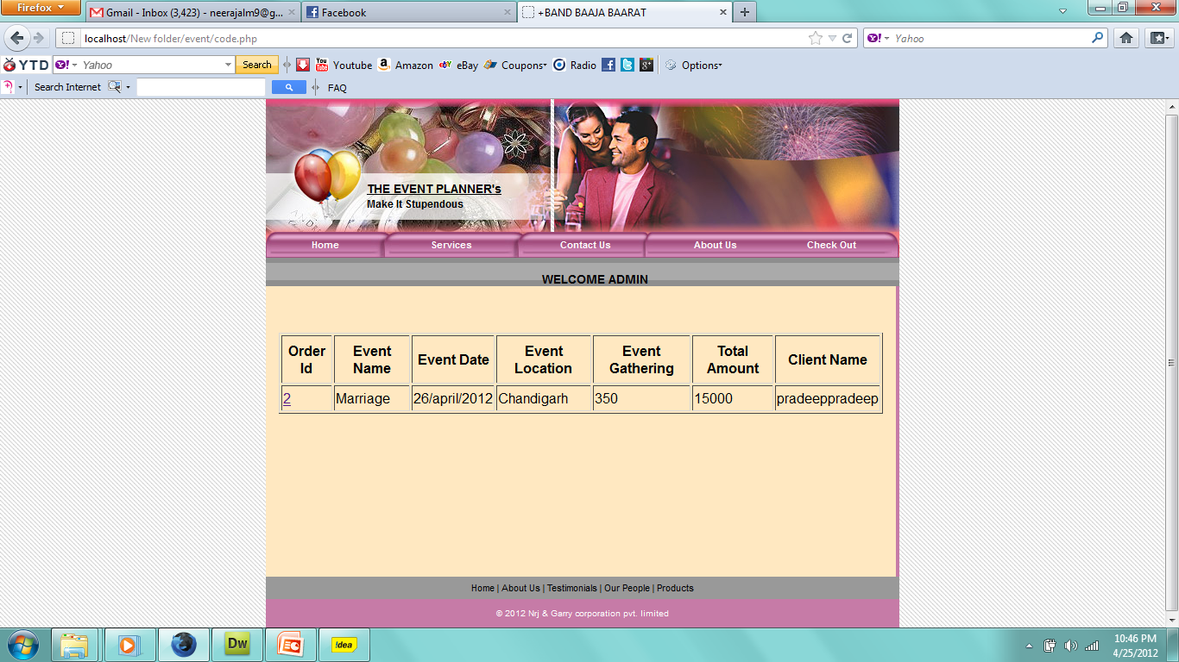
Admin Login

Slide 14
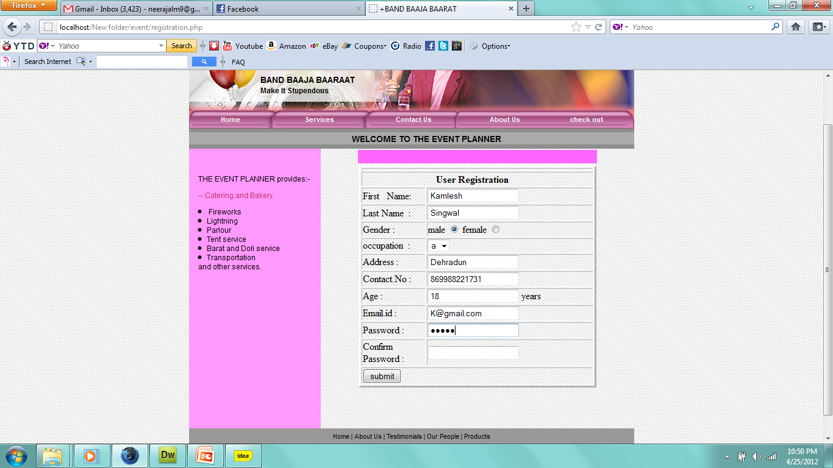
Sign Up for new clients

Slide 15
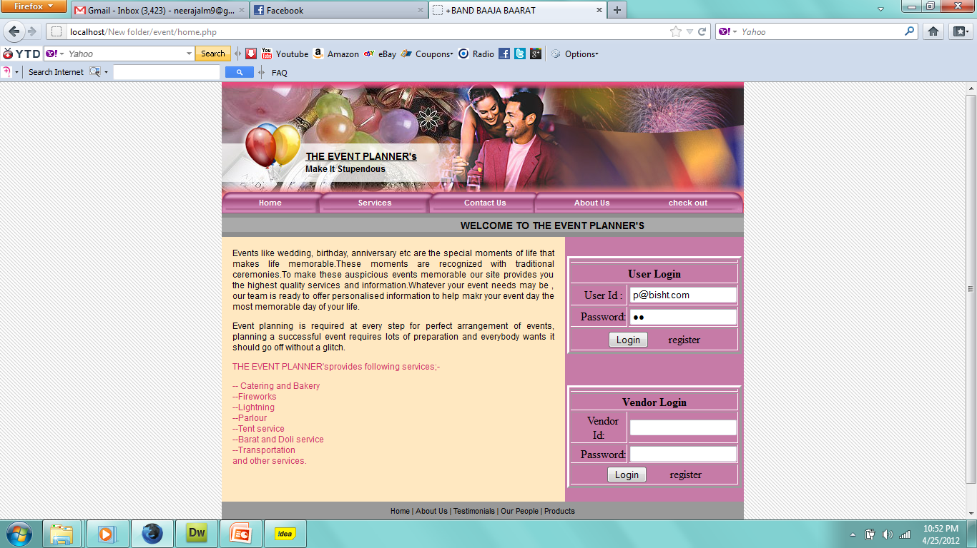
Client Login account

Slide 16
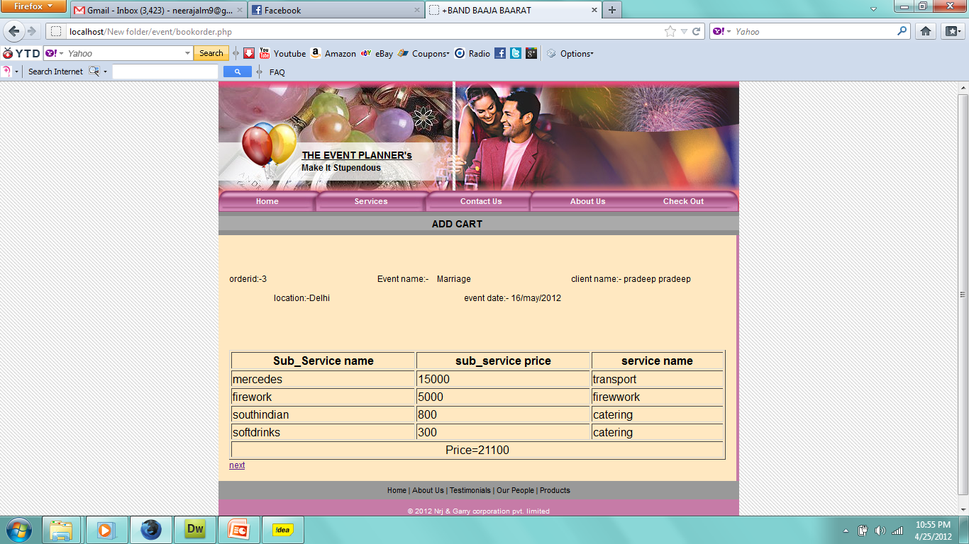
Client delivery report

Slide 17
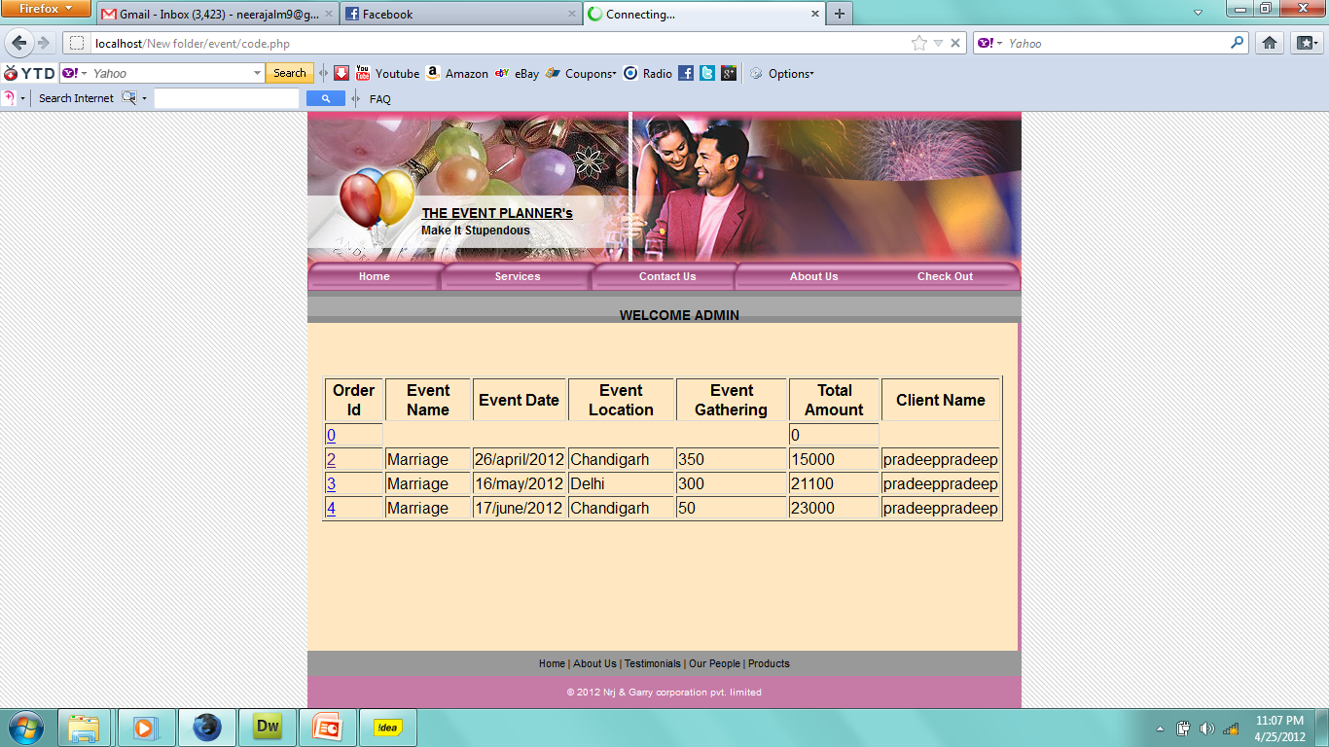
Admin Detail

Slide 18
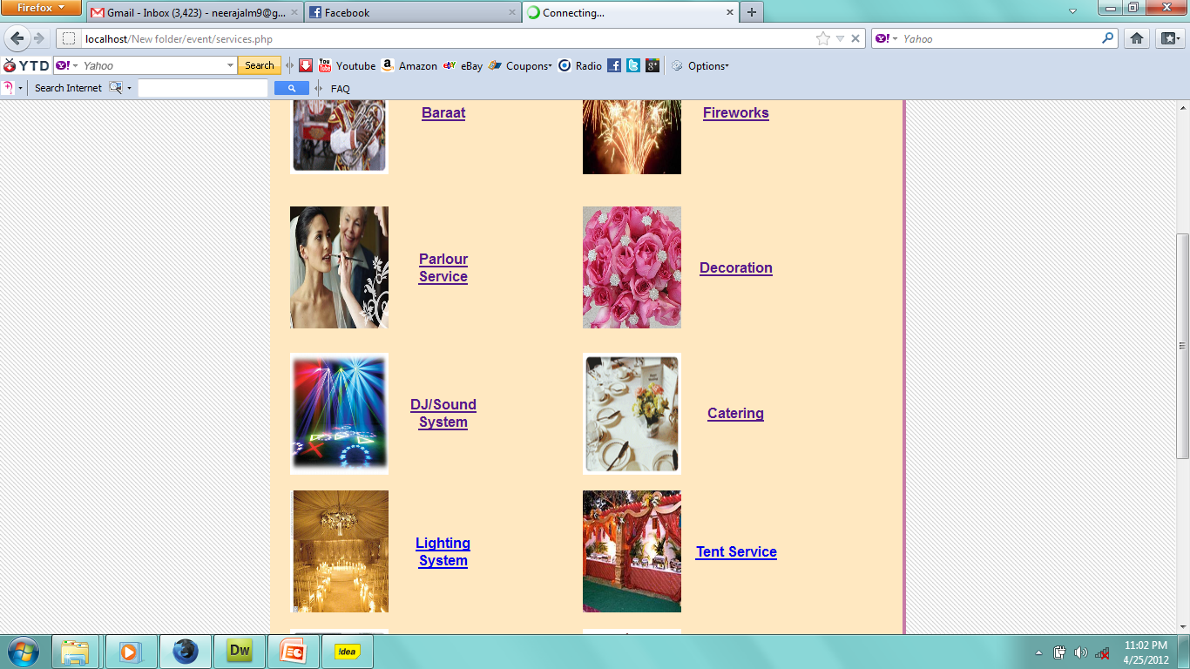
Product detail

Slide 19
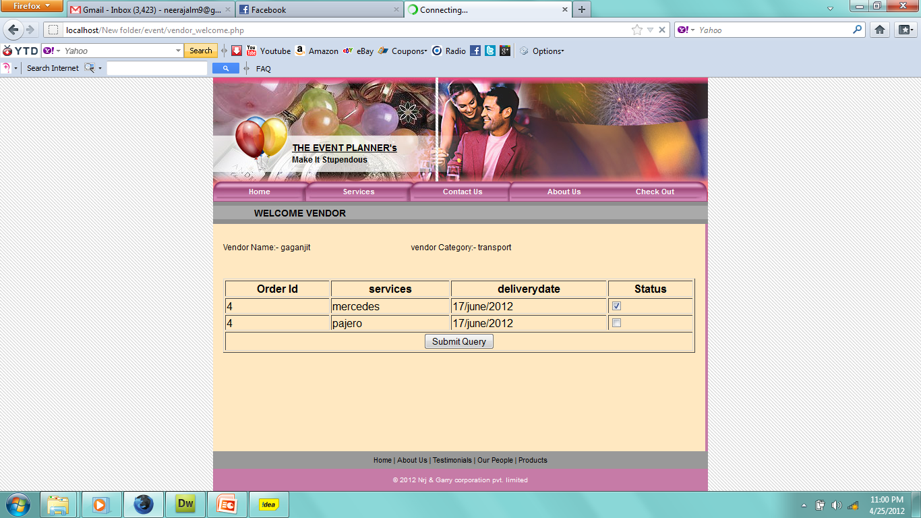
Order detail

Slide 20
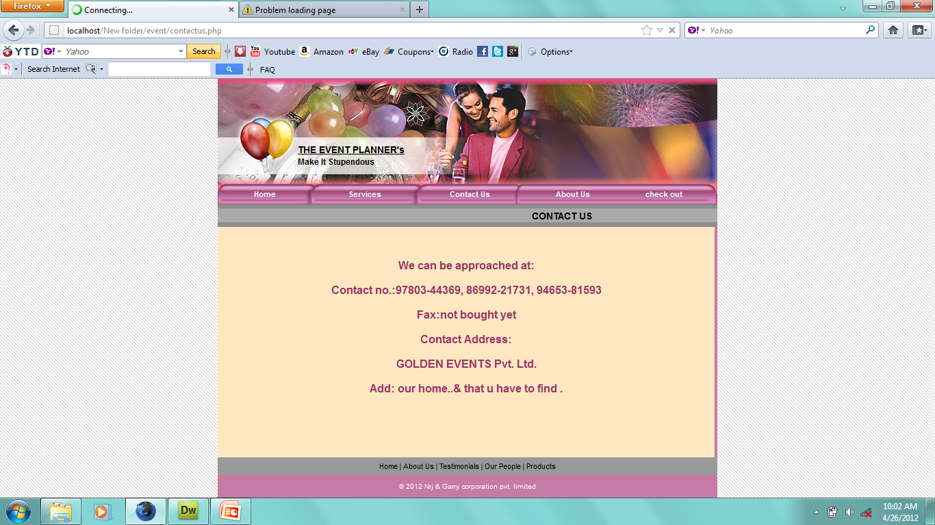
Contact Us

Slide 21
Thank You…………

